Slide 1
MyLegion.org
My Groups Administrative Tasks
- Manage membership
- Membership reports
November 2022
Notes:
MyLegion is The American Legion’s membership website. Through MyLegion, members of The American Legion and Sons of the American Legion can view and manage their membership on file at National Headquarters. Adjutants and commanders, through their individual accounts, will have a My Groups area to assist with post and squadron administrative tasks.

Slide 2
My Groups
Administrative area of MyLegion
Administrative Officers: Adjutants and Commanders
Membership Management, LGN and SAL
Reports and Labels
Membership Processing
Group Attributes and contact information
Notes:
My Groups is the administrative side of myLegion.
<1> Adjutants and Commanders are administrative officers and are provided post and squadron membership through their individual MyLegion account. If you do not have a My Groups menu and are an adjutant or commander, contact your department headquarters.
<2> My Groups includes membership details and management tools for Legion and SAL members.
<3> Reports and labels
<4> Online Membership Processing
<5> and Group Attributes and contact information.

Slide 3
GROUP | ADMINISTRATIVE OFFICER
Post | Post Adjutant Post Commander
Squadron | Squadron Adjutant Squadron Commander
County | County Adjutant County Commander
District | District Adjutant District Commander
Detachment | Detachment Adjutant Detachment Commander
 | Group Administrator
What is a group?
Departments process membership through MyLegion.
Notes:
Group is a new term used within the new membership system.
<1>Groups are defined as post, squadron, county, district and detachment. Adjutants and commanders and have My Groups by default and it is accessed their member account.
Administrative officers have authority to assign permission to others. Group administrators are members that do not hold an administrative officer position but have been provided permission to a group.

Slide 4
GROUP | ADMINISTRATIVE OFFICER
Post Post Leadership | Post Adjutant Post Commander
Squadron Squadron Leadership | Squadron Adjutant Squadron Commander
Detachment Detachment Leadership | Detachment Adjutant Detachment Commander
Notes:
Posts, squadrons, and detachments will have a Leadership group. Leadership groups provide a listing of the officers reported. It is not the group to select to preform administrative tasks.
Reporting of officer’s continue to go through your department headquarters using the Officer Certification form. Officer updates cannot be made through MyLegion.

Slide 5
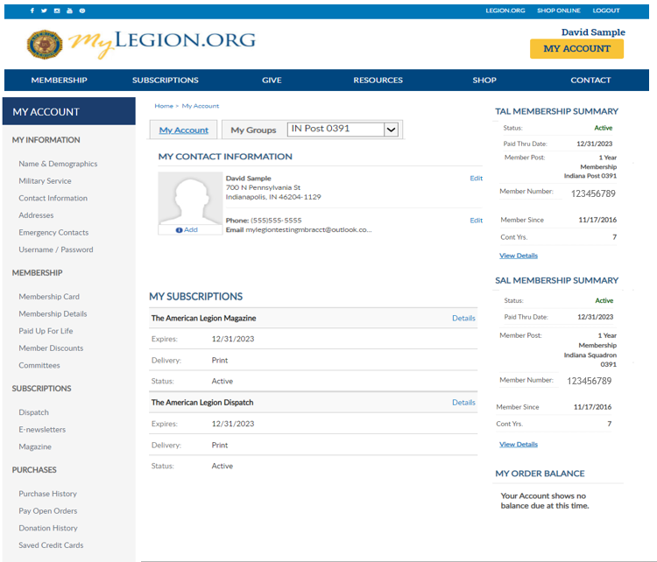
Notes:
The My Account window displays information about your individual membership. The left menu options are tools related to your membership information only. To view and manage members of a post or squadron, adjutants and commanders along with any assigned administrators will have a My Groups menu.

Slide 6
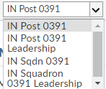
Notes:
Post Adjutants have access to both post and squadron membership and leadership groups. <1> Let’s take a look at a leadership group. <2>
Clicking on group will navigate you to the administrative side of MyLegion. Please watch for the spinner indicating the page is loading.

Slide 7
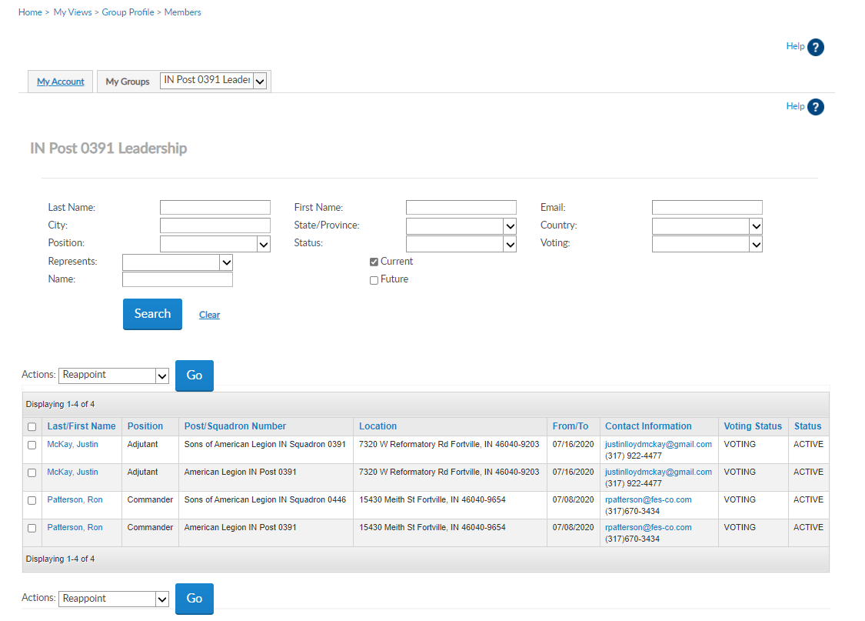
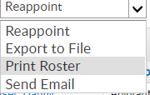
Leadership Groups
District and County officers do not see Officer’s Group.
Notes:
Leadership group displays the officers on file with contact information. Reappointment in the Actions menu is restricted. Officer updates are reported through your department headquarters.
<1> The actions menu allow to print a listing, send emails, or export.
Now let’s move to the group that allows administrative tasks. From the My Groups menu, select the post or squadron. <2> In this example we will transition to IN Post 391.

Slide 8
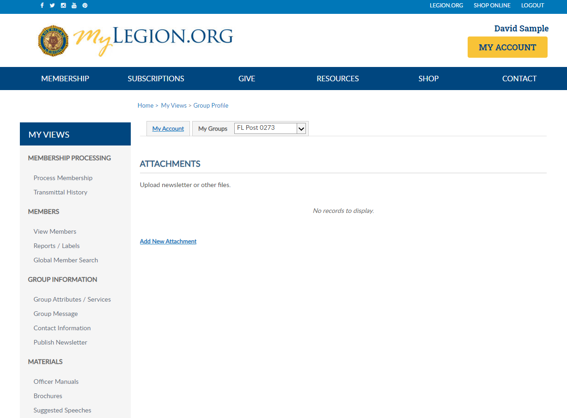
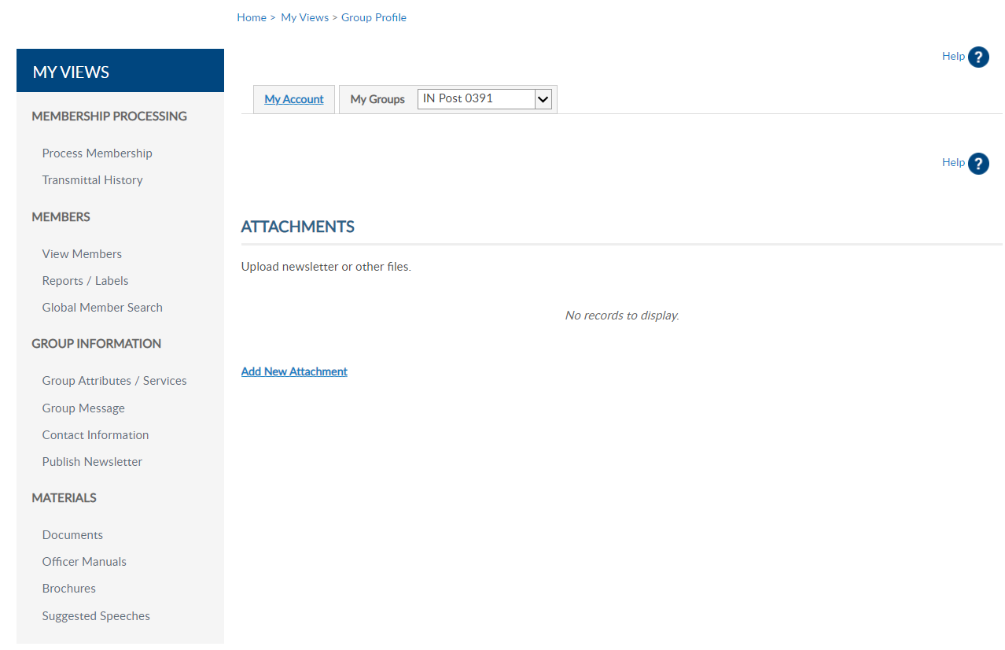
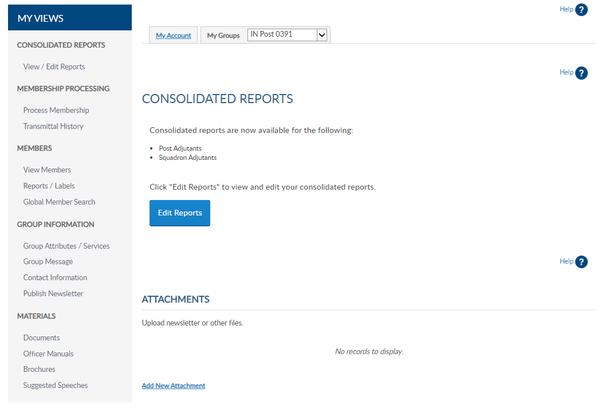
David Sample
Notes:
My Groups displays a left menu different than when you are in the My Account area. Left menu options provide links to tools and online resources to assist with membership management, online membership processing, and reports.
The group profile page and menu items may vary dependent on the position held. Post and Squadron Adjutant’s dashboard will have consolidated report. Consolidated reports are restricted to adjutants only.
<1> View Members takes you to membership list.

Slide 9
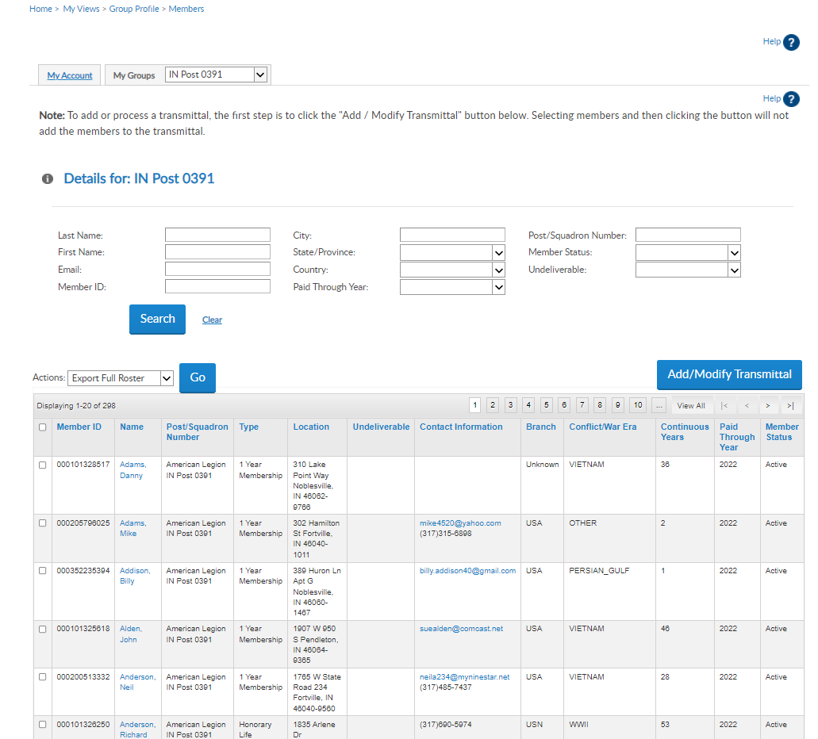
View Members
Notes:
The member list includes current and expired members. The Paid Through Year <1> displays the last membership year the member has paid.
On your list you may see members that display as last paid year of 2024. <1> These are members that were paid for the current year (2023) and purchased a Paid Up For Life membership. Although the records shows 2024, the member is still considered a PUFL member when their application is processed. The member is mailed a PUFL card when they sign up, by national headquarters.

Slide 10
View Members
Lists with >2000 records must be exported to view all records.
Notes:
A common question asked is “Can we sort this list?” the answer is yes. While viewing list <1> click the column title to sort by and the list will resort.
View Members area is designed to search and edit member information, send emails, and export to PDF or Excel spreadsheets. The member list is not the location to create roster reports or mailing labels. To create a roster return to group profile <2> and go to Reports/Labels.
To view and edit member information, click on the member’s name. <3> Notice the name is a blue hyperlink. Hyperlinks lead to more information. Selecting a hyperlink does not change membership information.
Lists that include 2000 records and above should be exported to another application. Viewing the list from the grid will not display all members.

Slide 11
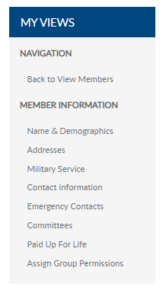
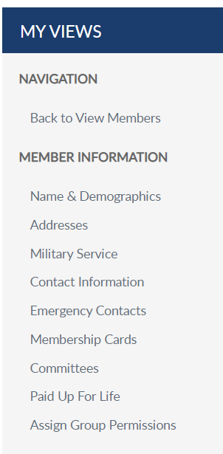
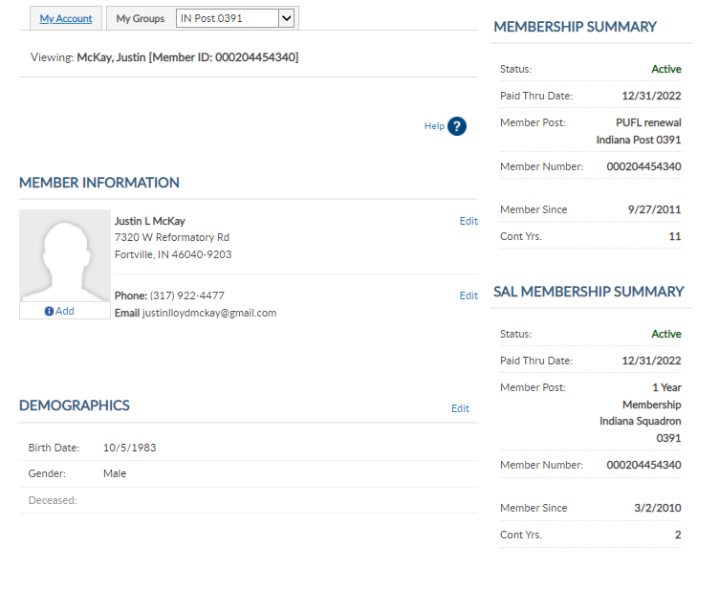
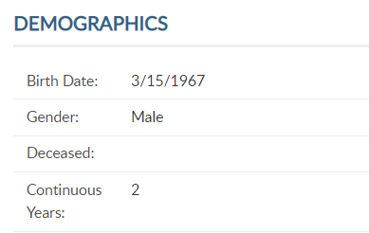
Viewing: Sample, Edward {Member ID 000111222333}
12/31/2023
000111222333
Edward Sample
5745 Lee Road
Indianapolis, IN 46206
13
Phone: (317) 555-5555
Email: edwardsample@outlook.com
05/23/1983
000111222333
13
12
Notes:
Viewing a member displays membership details including main contact information. This webpage provide access to information stored on National Headquarter’s membership system. <1>
Address, email, and phone number can be updated using edit links to the right or the left menu. To update a member’s name, you must use the left menu Name and Demographics.
Contact information will display a photo image if provided by the member. Members and Administrative officers can upload a picture by clicking Add. <2>

Slide 12
Viewing: Sample, Edward {Member ID 000111222333}
12/31/2023
000111222333
Edward Sample
5745 Lee Road
Indianapolis, IN 46206
13
Phone: (317) 555-5555
Email: edwardsample@outlook.com
NOTE: SAL continuous year updates are made by the post or department.
05/23/1983
000111222333
13
12
Notes:
The demographics area provides a quick glance of birth date, gender, continuous years and if the member is deceased. To update any of these demographics, click on the Edit button.

Slide 13
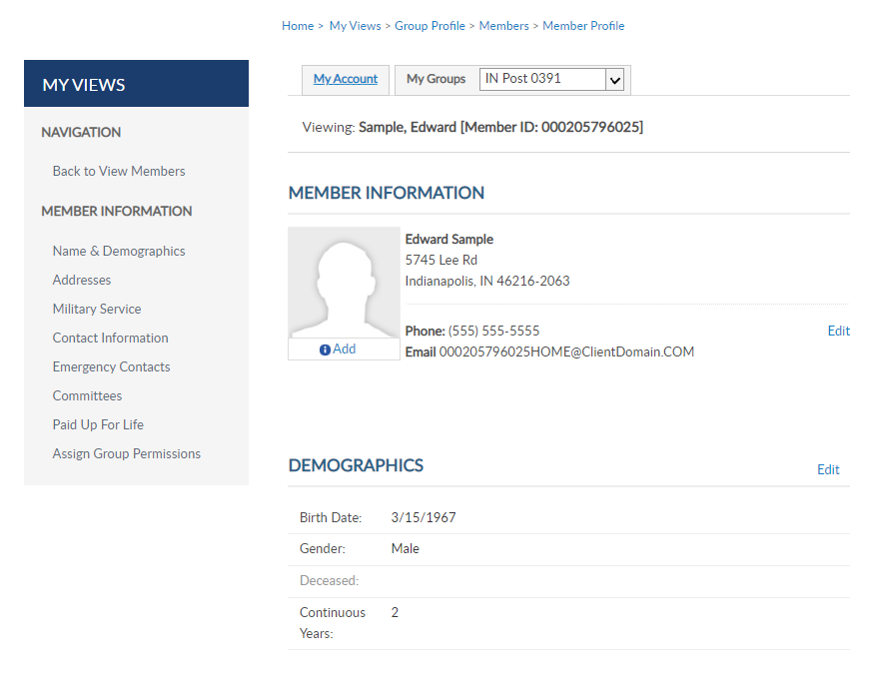
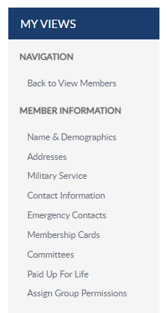
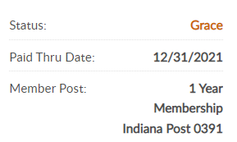
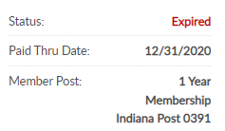
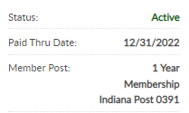
12/31/2021
12/31/2022
000111222333
12/31/2023
000111222333
Edward Sample
5745 Lee Road
Indianapolis, IN 46206
2
Phone: (317) 555-5555Email: edwardsample@outlook.com
05/23/1983
000111222333
Notes:
Membership summaries appear to view membership Status, paid through date, member number, join date and continuous years.
Members that belong to both The American Legion and Sons of The American Legion are known as Dual members. As of April 1, 2021 dual members will have the same membership ID number, providing 1 ID for both memberships.
<1>Member Post shows the post paid and type of payment, such as Paid Up For life, honorary life, department life, or if the member renews on a 1 year term.
The current member is a PUFL member of IN Post 391.
Other membership types and status include:
<2> Active 1 yr. member. The member is paid for current membership year and renews annually.
<3> Grace Status. Members not paid as of December 31 are delinquent. Beginning Jan. 1 -30 these members will fall into Grace member status. This is the period when non-paid members can renew before moving to expired status. The only time this status appears is during that time frame.
<4> Expired status. The member is currently delinquent with current dues. Members not paid as of Jan 30, are not in good standing, and lose their voting privileges.

Slide 14
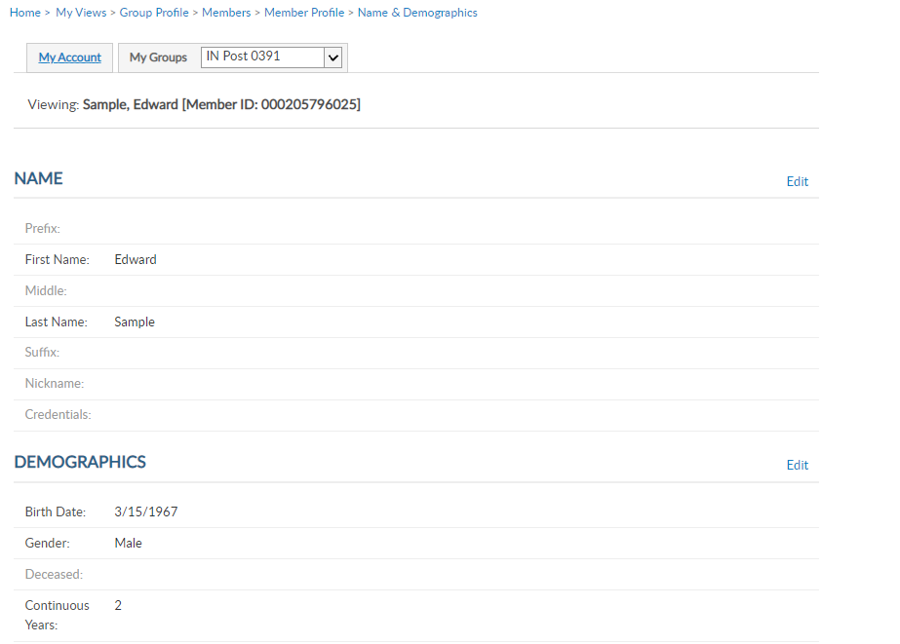
000111222333
000111222333
Ed
05/23/1983
000111222333
Notes:
Selecting Name and Demographics allows name updates, along with date of birth, gender, continuous years and deceased status. Names can only be updated in this area. Click on Edit to make updates. <1>

Slide 15
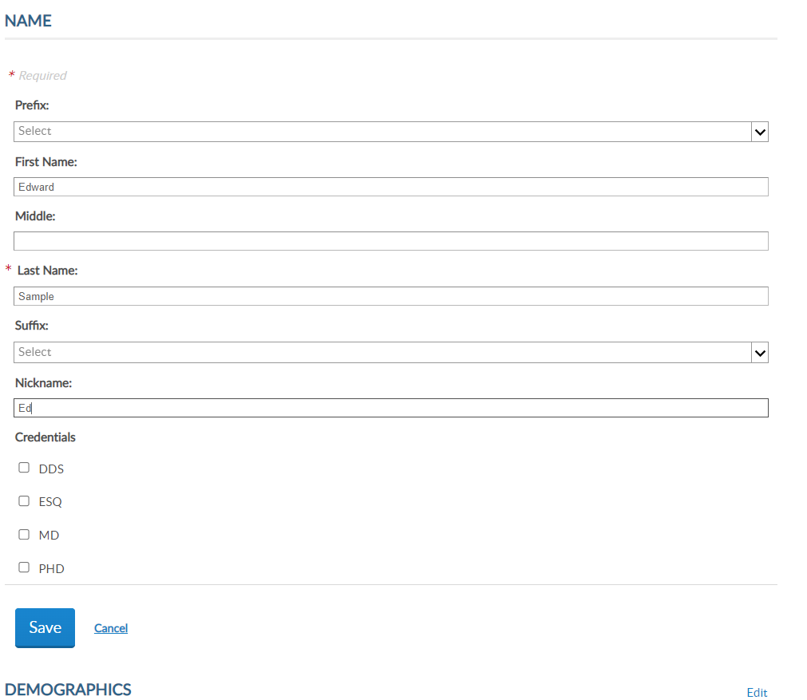
Viewing: Sample, Edward {Member ID 000111222333}
000111222333
Edward Sample
5745 Lee Road
Indianapolis, IN 46206
Phone: (317) 555-5555Email: edwardsample@outlook.com
05/23/1983
000111222333
Notes:
Enter updates and Save. <1> Name updates are saved separate from the demographics section. To update date of birth, gender, continuous years, or flag a member as deceased, click the edit button for Demographics. <2>

Slide 16
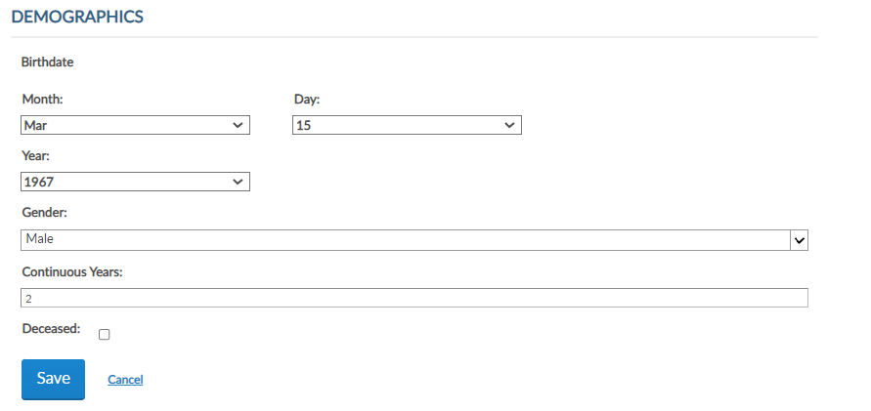
Notes:
Demographic updated include date of birth, gender, continuous years and deceased status. To flag a member deceased, check the box next to deceased. <1> Save any updates to return to the member record.
Members that are marked as deceased in error cannot be updated through MyLegion. Contact your department headquarters and provide the member ID# to have the record corrected.

Slide 17
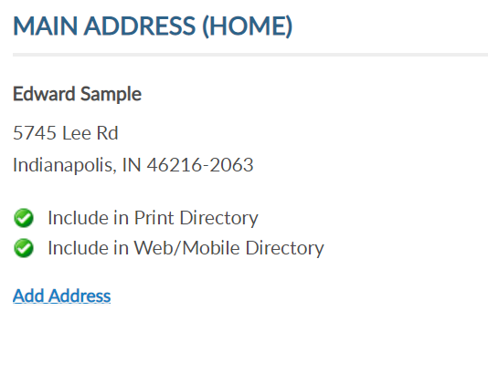
Viewing: Sample, Edward {Member ID 000111222333}
000111222333
Edward Sample
5745 Lee Road
Indianapolis, IN 46206
Phone: (317) 555-5555Email: edwardsample@outlook.com
05/23/1983
000111222333
Notes:
The address link allows you to update and add an additional address to the member’s record. Click the edit button to update. To add an additional address, click Add Address<1>

Slide 18
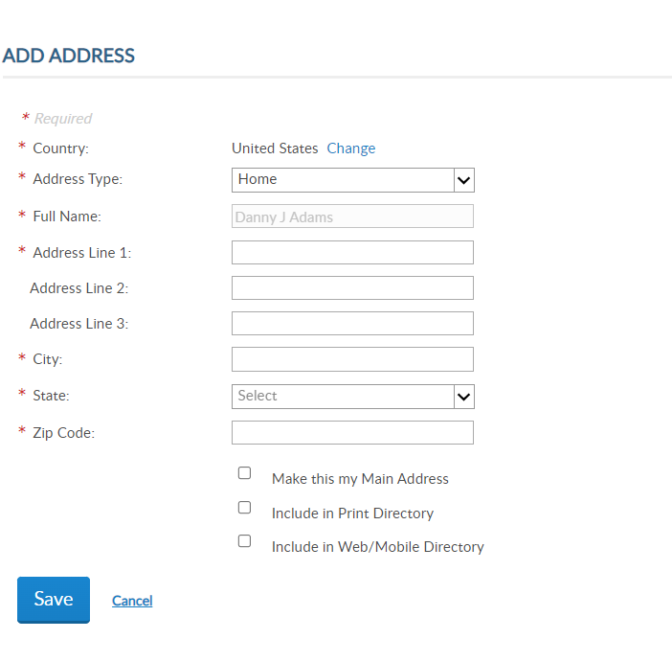
Viewing: Sample, Edward {Member ID 000111222333}
000111222333
Edward Sample
5745 Lee Road
Indianapolis, IN 46206
Edward Sample
Phone: (317) 555-5555Email: edwardsample@outlook.com
05/23/1983
000111222333
Notes:
To replace the primary mailing address, enter the address and check “Make this my Main Address”. The primary address listed on a member record determines where the address communications are from all Leadership levels, including renewal notices, campaigns and membership information.
Enter the information and Save.

Slide 19
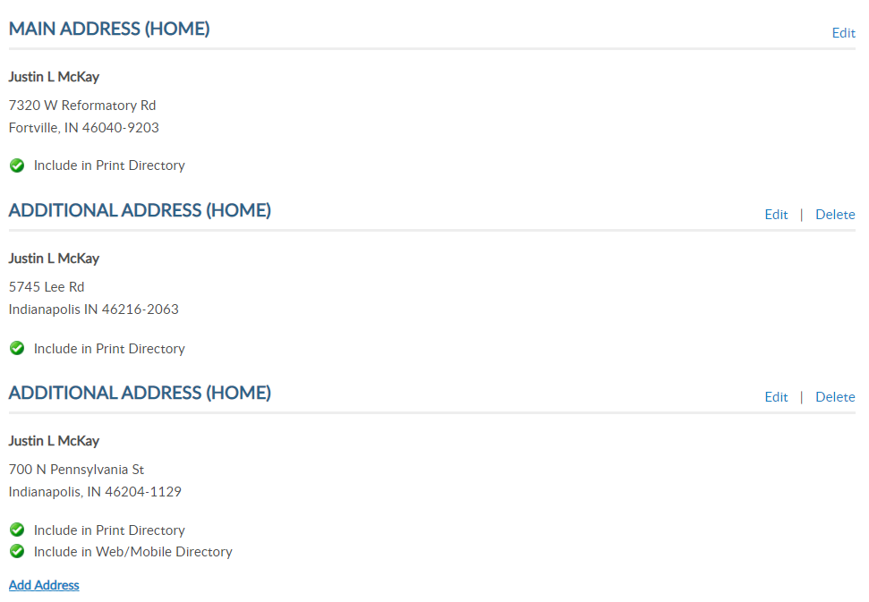
Viewing: Sample, Edward {Member ID 000111222333}
Edward Sample
700 N Pennsylvania St
Indianapolis, IN 46206
000111222333
Edward Sample
5745 Lee Road
Indianapolis, IN 46206
Edward Sample
Edward Sample
5745 Lee Road
Indianapolis, IN 46216
Phone: (317) 555-5555Email: edwardsample@outlook.com
Edward Sample
PO Box 1055
Indianapolis, IN 46206
05/23/1983
000111222333
Notes:
You can add multiple address but only one can be marked as primary and is required. When 2 or more addresses are on file, the delete option is enabled.

Slide 20
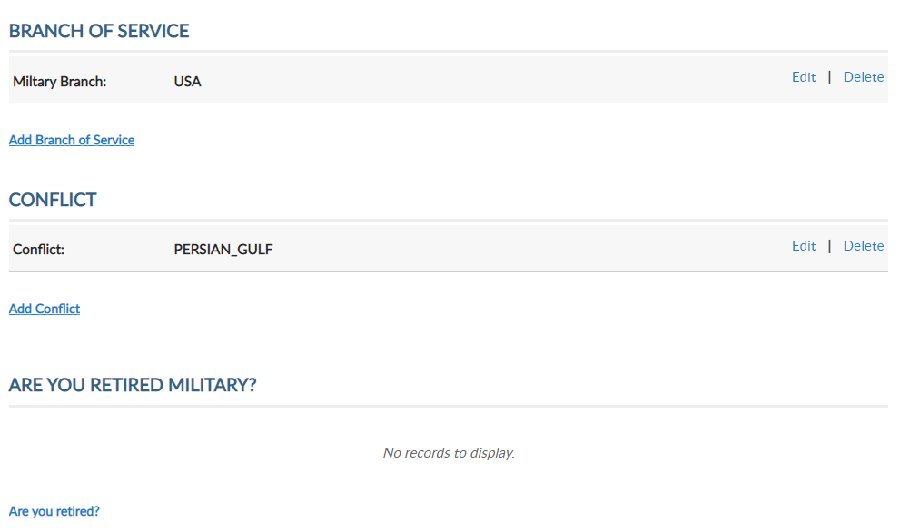
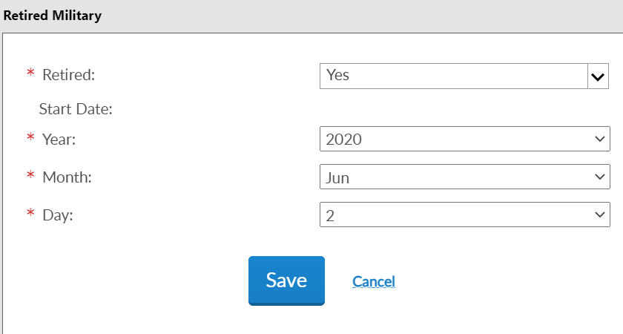
Viewing: Sample, Edward {Member ID 000111222333}
000111222333
Edward Sample
Phone: (317) 555-5555Email: edwardsample@outlook.com
05/23/1983
000111222333
Notes:
Military Service includes branch of service, conflict and retirement information.
This information can be corrected using Edit, deleted, or add another. Many of our members served in multiple conflicts and branches of service. MyLegion now allows multiple selections to be stored on the member record.
Through MyLegion members can add if they are retired with a date of retirement. <1> This provides the date the member retired from the military.

Slide 21
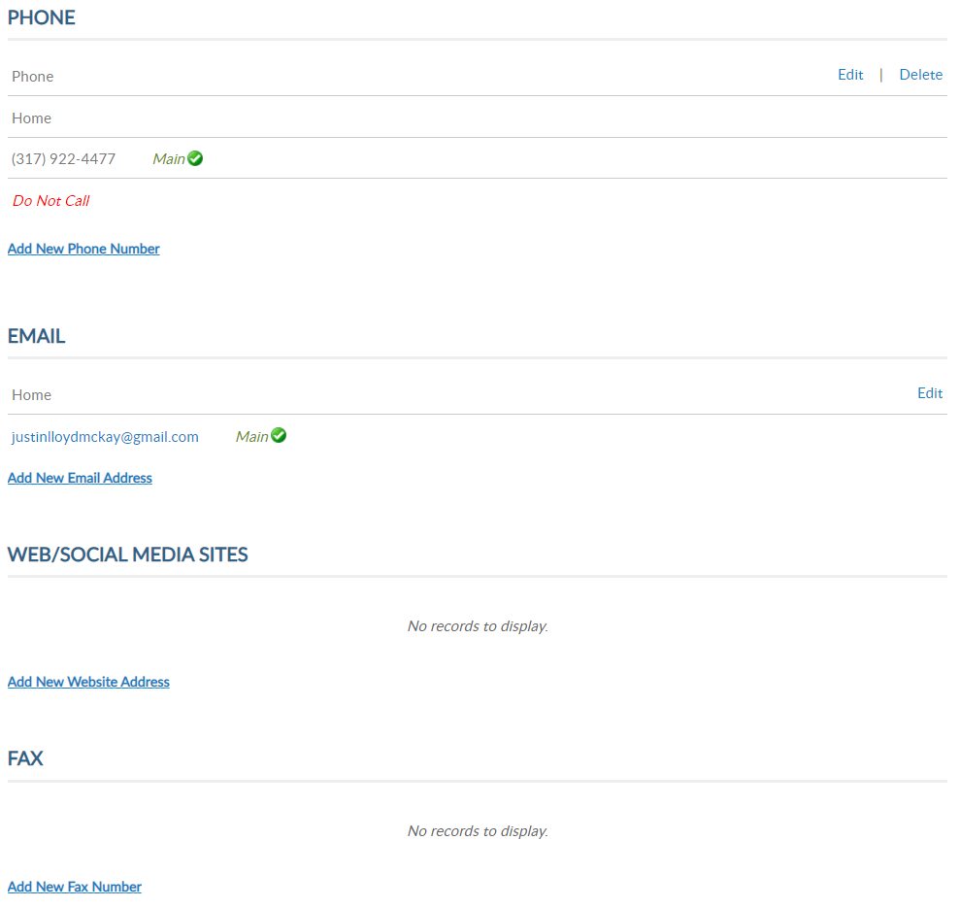
Viewing: Sample, Edward {Member ID 000111222333}
000111222333
(317) 555-5555
Edward Sample
Phone: (317) 555-5555Email: edwardsample@outlook.com
myemail@yahoo.com
05/23/1983
000111222333
Notes:
Contact information includes phone number and email address.
Phone and email address information can be updated using, edit, delete or add.
If one email is on file, no delete option will be available, and you will have to contact National MyLegion support staff to delete. To replace their email, select edit.
Member’s can have multiple emails. A total of 3 emails can be on a member’s record.
Updating primary email addresses affect the member’s MyLegion account. All password and username communications are sent to the main address.

Slide 22
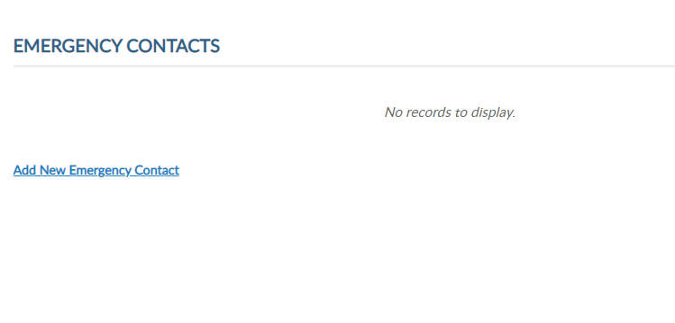
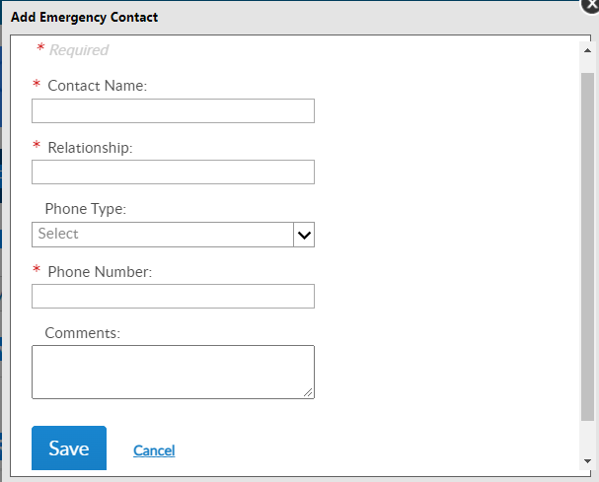
Viewing: Sample, Edward {Member ID 000111222333}
(317) 555-5555
000111222333
Edward Sample
Phone: (317) 555-5555Email: edwardsample@outlook.com
myemail@yahoo.com
05/23/1983
000111222333
Notes:
Emergency contact information allows members to provide who to contact in case of an emergency.
<1> Members can store on their member record emergency contact name, relationship, phone number with comments. This information can be seen by department and national staff in case of an emergency if the member attends events and conventions or local activity of The American Legion or Sons of The American Legion.

Slide 23
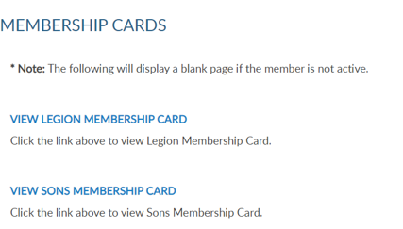
Viewing: Sample, Edward {Member ID 000111222333}
000111222333
Edward Sample
Phone: (317) 555-5555Email: edwardsample@outlook.com
myemail@yahoo.com
05/23/1983
000111222333
Notes:
Through MyLegion, you can now print a membership card for a member. Membership must be current and the online card does not include a signature. Both Legion and SAL cards can be printed.

Slide 24
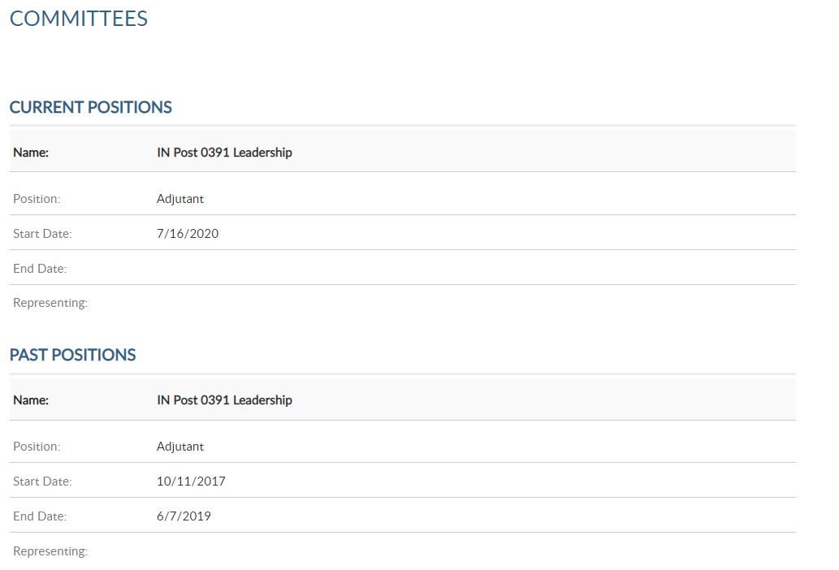
Viewing: Sample, Edward {Member ID 000111222333}
(317) 555-5555
000111222333
Edward Sample
Phone: (317) 555-5555Email: edwardsample@outlook.com
myemail@yahoo.com
05/23/1983
000111222333
Notes:
Committees lists offices held that are recorded on National’s membership system. It will display future, current and past positions.
This area is view only and reflects officers reported to National HQs. Officer updates are reported through your department using a post officers certification form. Incorrect committee information should be reported to your department.

Slide 25
Assist member with Paid Up For Life application.
Notes:
Paid up for life allows you to assist members with the online application.
Members that are already PUFL and expired members, will result in an error.

Slide 26
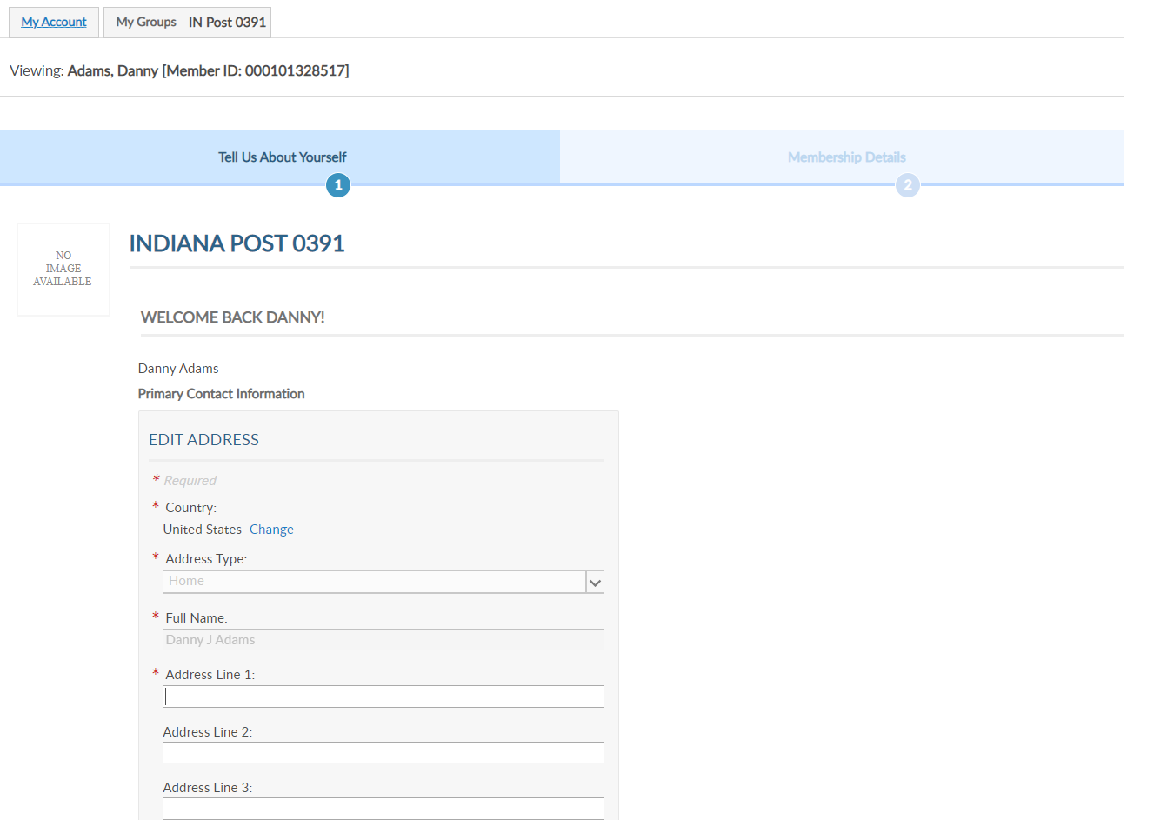
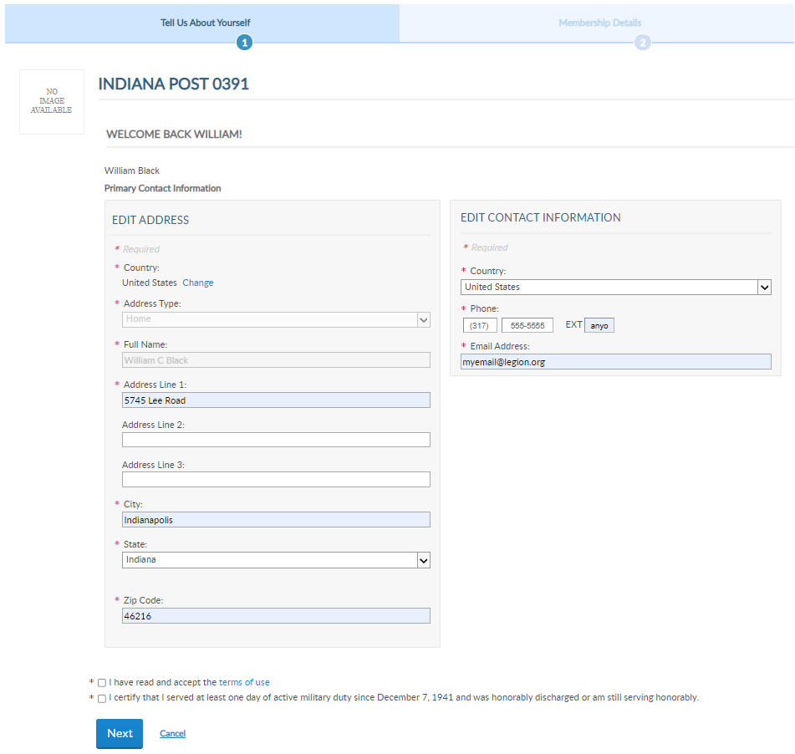
Viewing: Sample, Edward {Member ID 000111222333}
WELCOME BACK EDWARD!
Edward Sample
Edward Sample
Notes:
For members that are eligible for PUFL, MyLegion allows you to generate through the PUFL application.
<1> To proceed you must check both boxes at the bottom of the page and click Next.

Slide 27
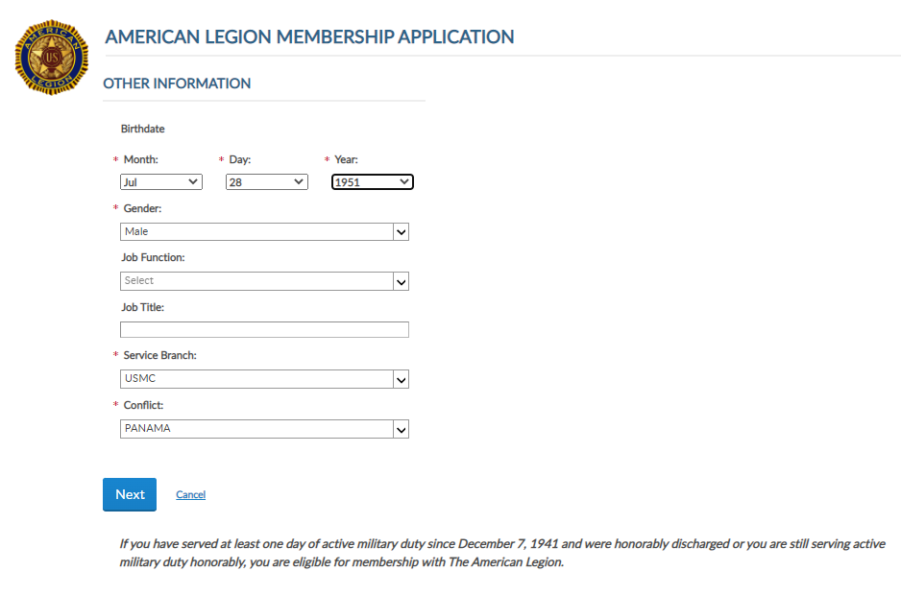
Viewing: Sample, Edward {Member ID 000111222333}
Notes:
Date of birth is a required field. PUFL pricing is calculated using post dues and birth date. Click Next to proceed.

Slide 28
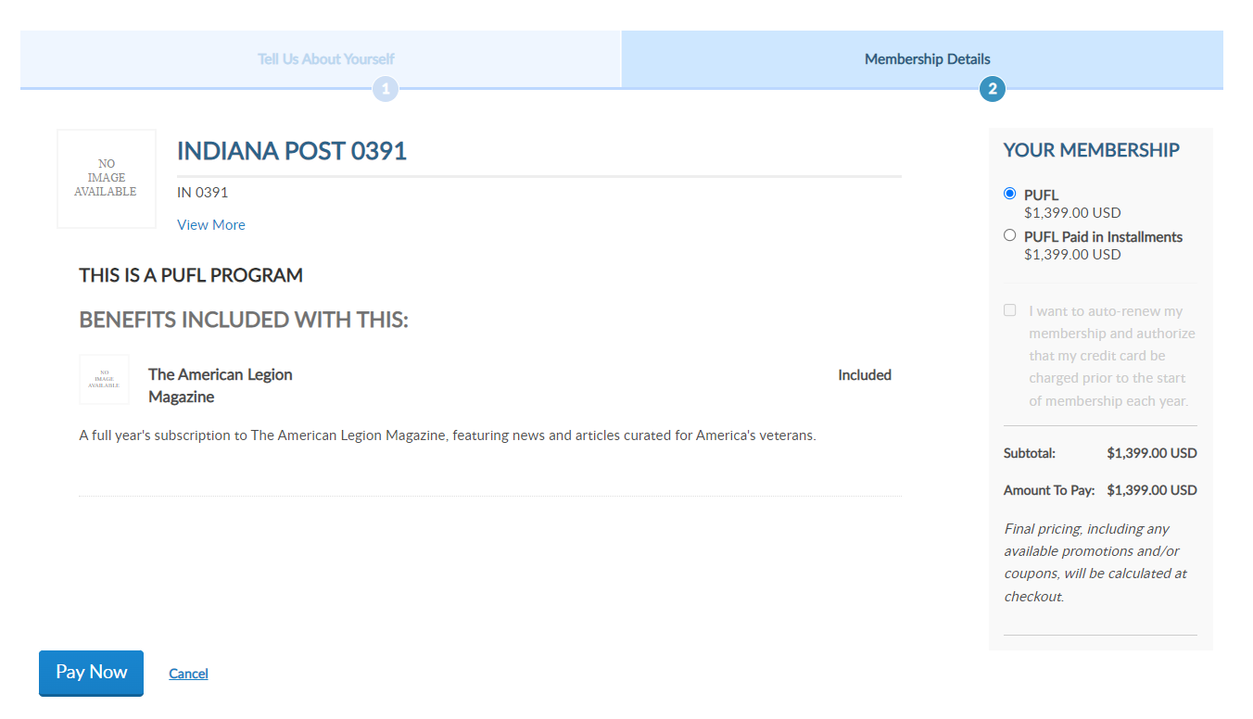
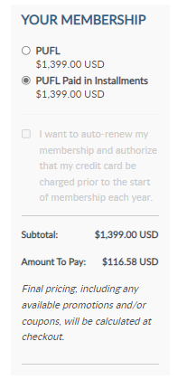
Viewing: Sample, Edward {Member ID 000111222333}
WELCOME BACK EDWARD!
Edward Sample
Notes:
The amount due displays to purchase in full.
Click Installments. <1> To view pricing for a 12-month time pay option.
Selecting Pay Now navigates to make a payment or cancel and return to My Groups.

Slide 29
Viewing: Sample, Edward {Member ID 000111222333}
000111222333
Edward Sample
5745 Lee Road
Indianapolis, IN 46206
Phone: (317) 555-5555Email: edwardsample@outlook.com
05/23/1983
000111222333
Notes:
Assign group permissions should be used with caution. This tool allows adjutants and commanders to grant access to post and squadron membership to other members.
To add, delete or edit management settings, click Edit. <1>

Slide 30
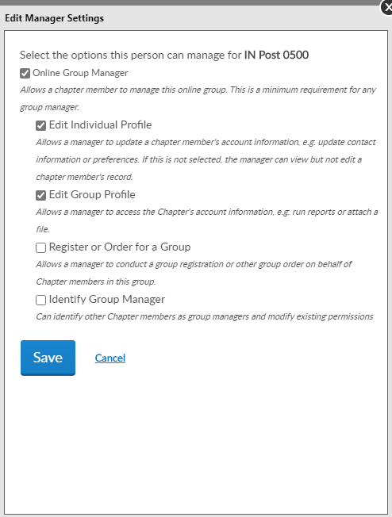
Group Permissions
Online Group Manager
Export and print member list.
Quick link to email address.
Online Membership Tools: View Members, Global Member Lookup, Group Attributes, Reports/Labels, Process Membership, Officer Materials
Edit Individual Profile
View and edit member information
Edit Group Profile
Displays My Views menu.
Notes:
To provide the same access adjutants and commanders have select:
Online Group Manager. <1> This is the minimum permission requirement. <2> It provides access view members and a quick link to member email addresses. It also provides access to online membership tools in View Members –– Global Member Search –Group Attributes - Reports/Labels – Process Membership. and Officer Materials. Selecting this option only results in view only access and records cannot be updated.
<3> Check Edit Individual Profile to grant authority edit member information.
<4> Edit Group Profile should be checked with Online Group Manager. This adds the My Views menu when entering the My Groups area.
After the desired management settings are assigned, click on the Save button.

Slide 31
Group Permissions
Register or order for a group
Identify group manager
Notes:
There are a few additional group permissions that are focused on future enhancements.
Register or Order for a Group provides permission to make purchases, donations and register events on behalf of the group with the payment information saved on the account. This permission is for future enhancements purposes only and at this time has no function.
The last setting to check is Identify Group Manager. This permission provides this member full administrative rights. If you do not want this member to make group permissions do not check this box.

Slide 32
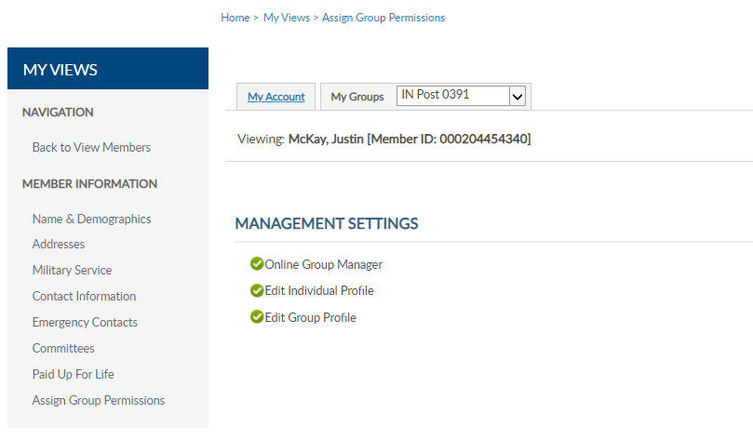
Group Permissions
Viewing: Sample, Edward {Member ID 000111222333}
Contact Department HQs or National MyLegion Support to add an end date for permissions.
Notes:
Permissions added will display. The next time the member logs into their myLegion account, they will have access group membership.
<1> Select back to view members to search more names, or select My Groups to return to the group home page.
It is important to keep track of anyone given permissions. No end date is set when applying these permissions. Permissions can be removed by returning to Edit and unchecking the selections.
<2> To ensure members with permissions are monitored we suggest you contact your department headquarters or MyLegion support team to add an end date. Adding an end date will remove permissions to allow any new officers or existing officers to review the members administrative needs and re-assign if needed.

Slide 33
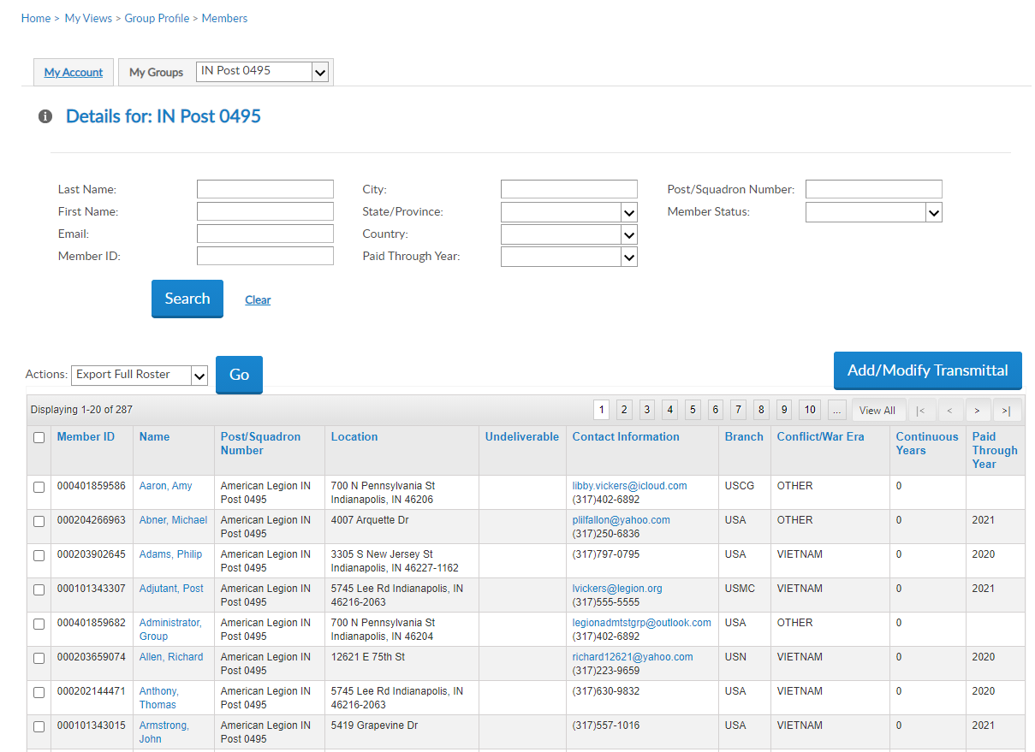
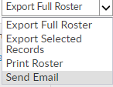
Email Members
Member List
Notes:
Emails can be sent from MyLegion. From the View Members listing, you can search a member, or a group of members and send an email.
To email and individual member, search them and click on the email hyperlink.
Email a group of members by first selecting the records. <1> The search fields allows you to filter the data. Select all records by clicking the checkbox in the title row. Using the Actions menu, <2> choose Send Email and click Go.
It may be required to set your browser based email preferences. Your email client such as gmail.com or yahoo.com provides help documentation for this set up.
The number of records emailed at one time and per day is also limited per the email client. Generally 100 per email and 500 per day. Check with the email client for limitations.

Slide 34
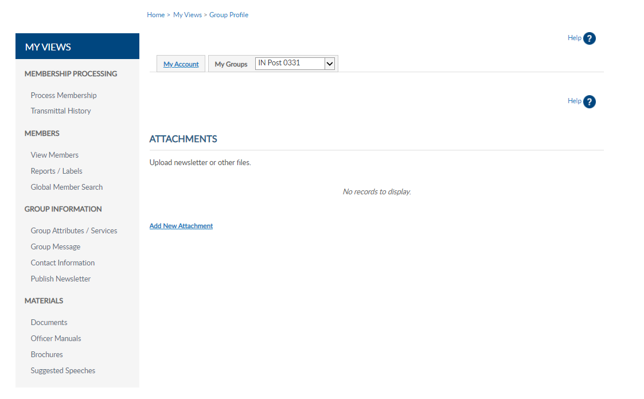
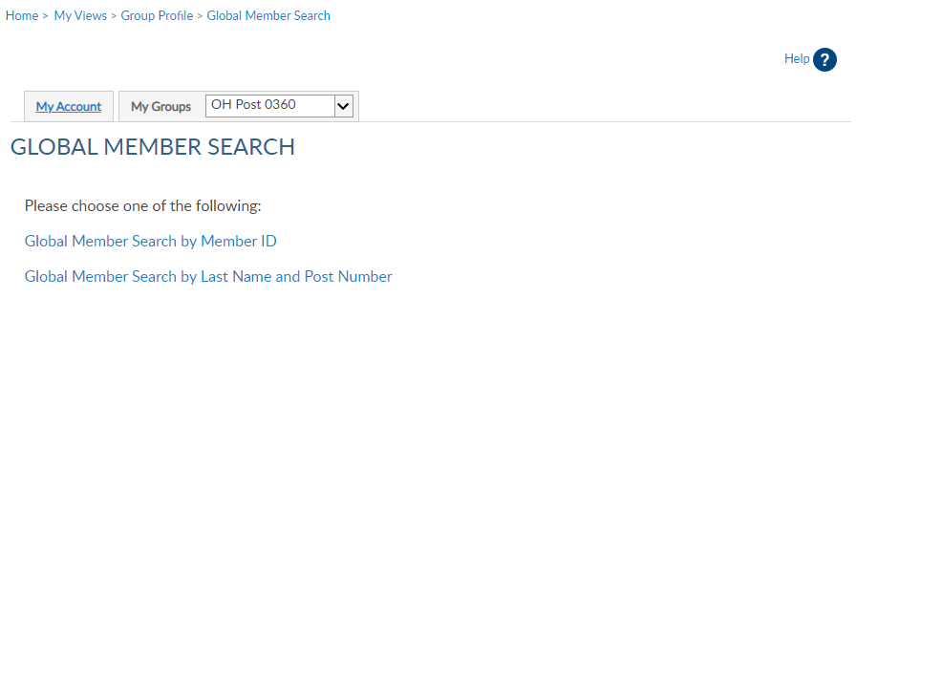
Global Member Search
111222333
Notes:
Global member search allows you to view members outside of your group. 2 options are provided. Search by ID or search by name with post number.
<1> Search by ID allows you to enter a Legion or Son of The American Legion membership number to view limited information. Click View Report to view name, member type, paid post, and last paid year.

Slide 35
Global Member Search
Notes:
Search by last name and post number requires both pieces of information. Click View Report to view.
This information can assist with transferring members and eligibility for The American Legion Auxiliary and Sons of the American Legion.

Slide 36
Reports
Consolidated Reports – CPR and CSR
Labels
Find Members In My Area – Distance by Zip Code
Find Members In My Area – Zip Listing
Member Online Renewal
Post /Squadron Current Roster
Roster Updates
New Reports!
Members Dues History
Project Stay Active
Notes:
Reports play a vital role when tracking membership. The next part of this presentation will review Consolidated Reports and other reports available through Reports/Labels.

Slide 37
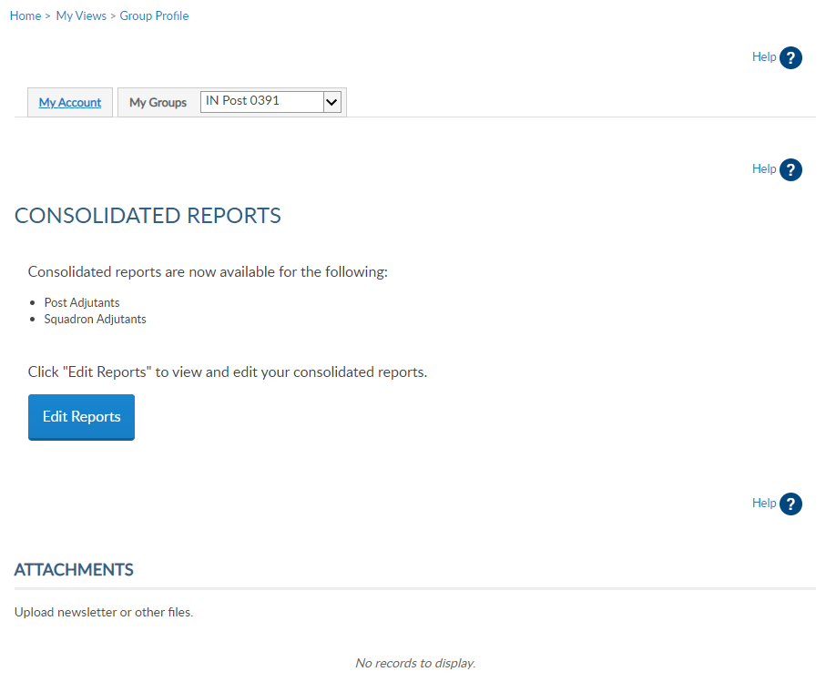
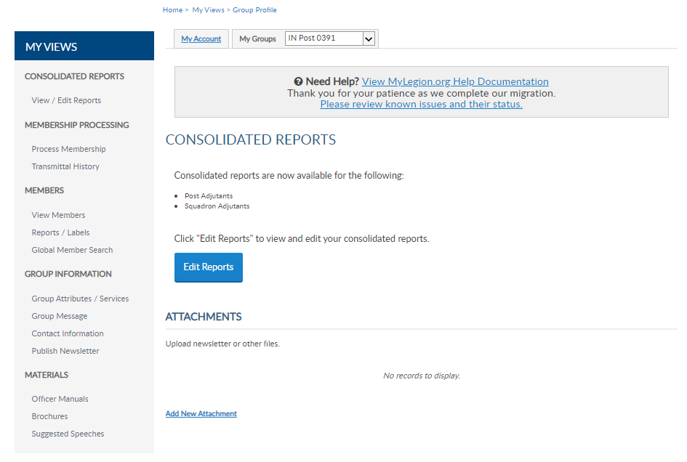
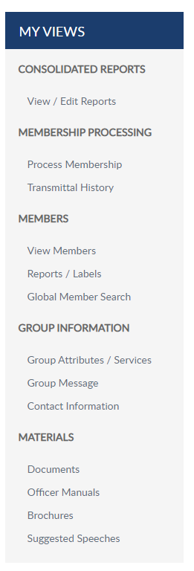
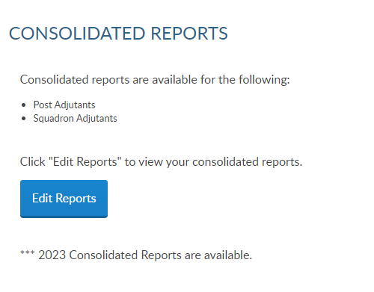
David Sample
Notes:
Consolidated reports are restricted to Adjutants and are located on the left menu. The only reports in this area are consolidated reports. Commanders and assigned administrators do not have access to consolidated reports. If you are a Commander or group administrator, your My Groups dashboard will not include Consolidated Reports.

Slide 38
Consolidated Report
David Sample
IN Post 0391
Notes:
There are 3 view areas in consolidated reports. Open includes the current report available to enter data. Consolidated reports are reviewed by the National Internal Affairs Division and closed during that time period. When the current report is available, is will be located in Open.
There is only one open report for the reporting year. When available, you can edit the report until it is finalized. Once, finalized the report is moved to closed.
To enter information in the report, click Edit. <1> Select edit to complete online. Selecting Delete will remove the online form. Choose one form to submit the report. If you submit online, you do not need to mail a paper form. The department has access to submitted report data.

Slide 39
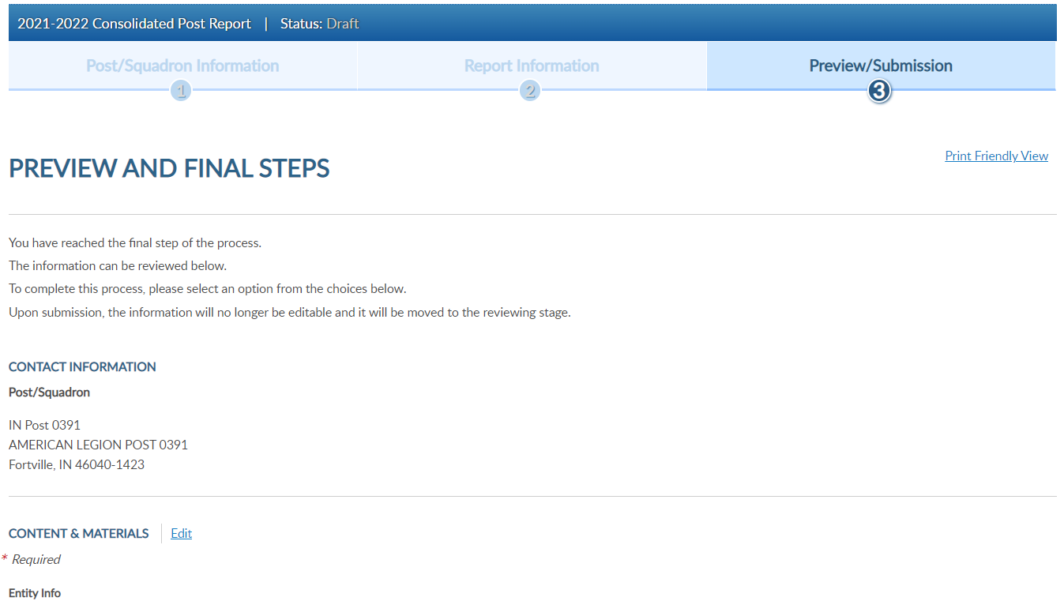
Consolidated Report
Notes:
Click edit to open the fillable form.

Slide 40
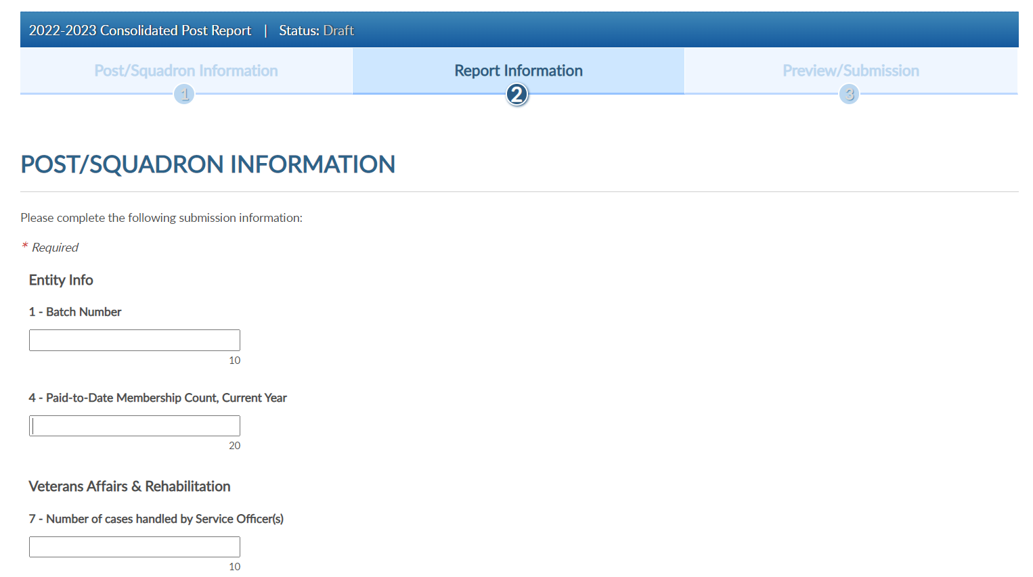
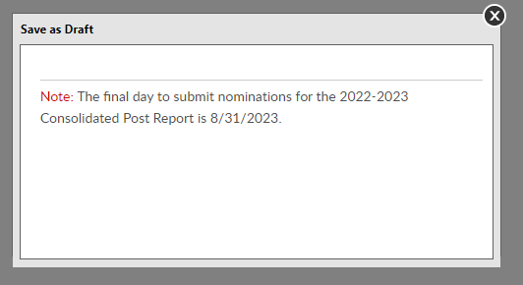
Consolidated Report
Notes:
Field 1 asks for batch number. This field can be left blank.
When youqr entries are complete save the draft or finalize the report. These buttons are located at the bottom of the form. <1>
To save and return to the form later, choose Save as Draft. <2> the draft must be finalized by August 31, 2023.

Slide 41
Consolidated Report
Notes:
To finalize the report, click Next. <1> and Submit Final.
Note, once the report is finalized it is saved as a submitted report. You will not be able to add data once submitted. If you plan to make additional updates, click Save as Draft and finalize by the due date.
This report does not need to be mailed if completed online.

Slide 42
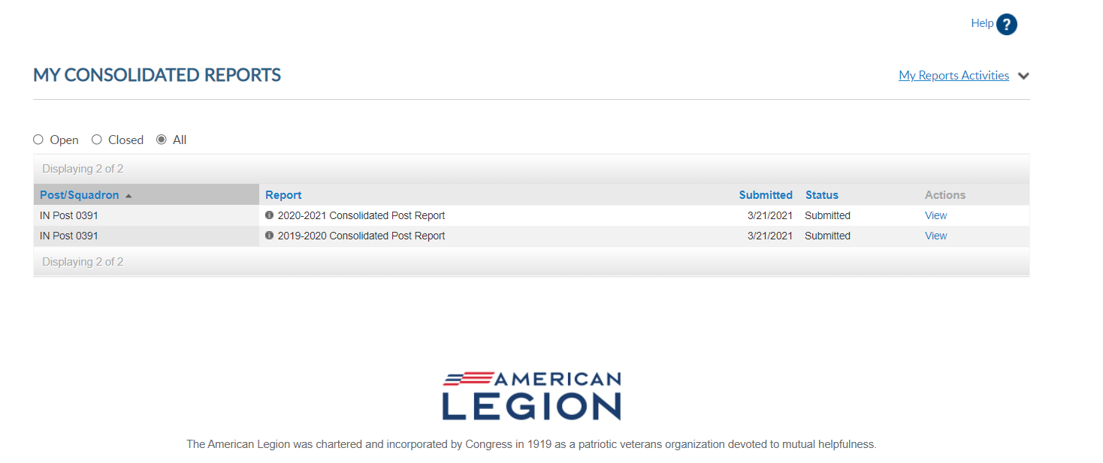
Consolidated Report
Closed Reports
David Sample
Notes:
Submitted reports will remain in the Open area with a submitted status until the report is closed for the year. To view, or print, click View.

Slide 43
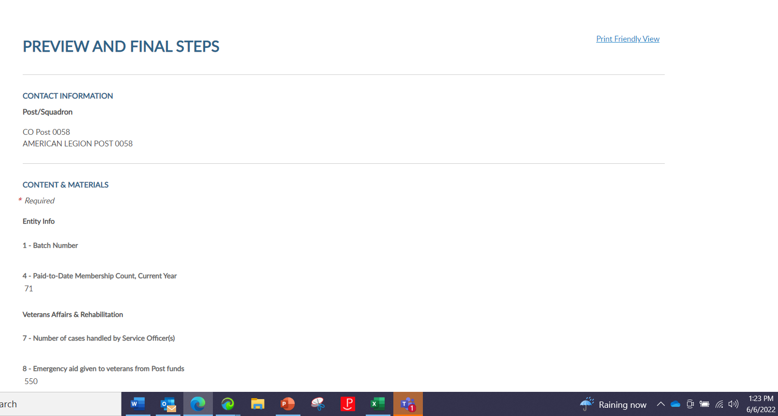
Consolidated Report
Closed Reports
David Sample
Notes:
To print the report, select Print Friendly View to advance to Print. <1> <2> This allows you to print the report as a PDF document.

Slide 44
Consolidated Report
Closed Reports
David Sample
Notes:
The All section includes current and previous years reports beginning 2019-20. Reports prior to 2019-20 are not available.

Slide 45
Notes:
Rosters, Roster Updates, Members Renewed Online, find HQ members, and create mailing labels through Reports/Labels from the left MY VIEWS menu.
Current reports area include the most used reports for managing members, revitalization, and communications to post and squadron members. The reports available will vary and are defined by officer position and permissions provided as a group administrator.
Notice the top links. <1> We are currently in the Reports/Labels page of MyLegion. To return to the main group page at anytime, click on Group Profile.
<2> Post and squadron reports include labels, current rosters and roster updates. Posts have additional reports that are related to headquarters members and online member renewals.
<3> District reports are restricted to district adjutants and commanders. These reports include membership for all posts and squadrons assigned to the district.

Slide 46
Mailing Labels
Notes:
3x10 labels produce a 30 per sheet label that fits Avery 5160 or any 30/sheet blank labels.
Click on the blue hyperlink to set filters and create labels.

Slide 47
Create Mailing Labels
Notes:
Filtering options allows you to define the members included in labels. Deceased and members flagged as undeliverable will be suppressed from mailing labels.
>1> The first step is to select the group.

Slide 48
Create Mailing Labels
Notes:
Select the last paid year or multiple years. Last paid options include current membership year minus 2. The last paid year of 2024 represents PUFL members that signed up and were already paid for 2023. The last paid year for paid up for life members reflect the year posts are re-imbursed for their PUFL allotment mailed annually. The last paid year filtering field for all reports will include 2024. To include all 2023 members, include 2024 to capture your PUFL members.
That action activates the sort option. <1> Designate if you want your labels sorted by last name or zip code.
<2> After parameters are set, View Report to continue. <3>

Slide 49
Name
Address
City, St, Zip
Name
Address
City,St, Zip
Name
Address
City,St, Zip
Notes:
The label display is not in 30/sheet format. Send the data to a PDF document selecting the export icon. <1> The export icon is used print and save all reports using the file types in the menu. PDF is the only selection that applies for labels. After you select PDF look for a tab to open the PDF generally located at the lower left of your window. <2>

Slide 50
Notes:
The PDF opens to print labels.

Slide 51
Find HQ Members
Notes:
To create a listing of HQs post members, begin in Reports and Labels – Find Members in My Area. This report can be generated 2 ways. By distance from zip code allows you to select one zip code and select a mile radius to search. Using the Zip Listing allows you to select multiple last paid years and multiple zip codes.
Find Members in my Area provides contact information for members in your state headquarters post. Click the Find Members in my Area blue hyperlink to set parameters and create report.

Slide 52
Notes:
Only zip codes within your group’s state are included. This report is not to be used to locate members in other departments. You can only select one zip code at a time. After the filters have been selected click ”View Report”. <1>

Slide 53
Notes:
Selecting Find Members Zip Listing allows you to select one or multiple zip codes. Select last paid year next and View Report.

Slide 54
Notes:
The report generates and is sorted alphabetically. It includes contact information on file at national headquarters. This listing can be exported to save or print using the export icon. <1>
This report can be used for revitalization. Contact these members, tell them about your post and invite them to transfer. In the past MyLegion report area, an invitation letter was available that is no longer available. The report developers are currently reviewing all previously available reports to incorporate through the My Groups area.
Using Microsoft applications Excel and Word, you can create a letter. Export data by to an Excel Spreadsheet.

Slide 55
Member Dues History
Notes:
To view a member’s payment history, go to Member Dues History.

Slide 56
Notes:
Enter the member’s name and organization. For members that hold a dual membership in both The American Legion and Sons of the American Legion, dues history will have to be run separately for each organization. <1> Select View Report to generate.

Slide 57
Member Online Renewal
Notes:
Legion members that renew online can be identified using the Member Online Renewals Report.
Online renewal is available for Legion membership only. Collection of Squadron dues rates is in process. If your squadron has not reported rates using the Squadron Data Forms, please encourage them to do so.
Click on the blue hyperlink to begin the members online renewal report. <1>

Slide 58
Notes:
Select your group <1> and date range parameters. Using the small calendar icons <2>, select the date range navigating from month to month using the left and right arrows. Click on the date in the calendar to set and View Report <3>.

Slide 59
IN0391
IN0777 $45.00 2021-07-14 2022 123456789 Joe Apple PO Box 123 Ind IN 46216
Notes:
This report provides the total count with names, member id#, date and renewal year. The amount paid displays the total amount of dues collected by the member, as reported on the annual post data report. When a member renews online, National collects post dues, and sends all others to the department to distribute.
If the post dues do not cover the minimum of national plus department, online renewal will not be available and result in an error message if the member attempts online renewal.

Slide 60
Page Navigation
Refresh
Export
Search
IN0391
IN0777 $45.00 2021-07-14 2022 123456789 Joe Apple PO Box 123 Ind IN 46216
Slide Bar
Notes:
All reports include a navigation menu. Go from page to page using the left and right arrows <1> , you can also use the slide bar at the right <2>
<3> The circle arrow icon refreshes your page. The export icon <4> is used to print and save reports. Reports are not saved within the report writer.
When viewing a report, you can search a member to see if they are included. <5> Enter a word or number and click Find.

Slide 61
Project Stay Active
Notes:
Locate members that have recently moved into your area to connect and see if they would like to transfer to your post. This listing is known as Project Stay Active.

Slide 62
Notes:
This report allow you to select a zip code and distance. After setting the filters, click View Report to generate. <1> The maximum distance search is 100 miles. Names drop from this list after 30 days from the time they move.

Slide 63
Post/Squadron Current Roster
Notes:
The next report is the post and squadron current roster. Current rosters include current membership minus 2 and members who have paid to your post, even if they have transferred out.
Select post/squadron Current Roster blue hyperlink to begin. <1>

Slide 64
District / County “Post Roster”
Notes:
When creating a roster, the membership included will be members of your group. District and county rosters will include members assigned to their area.
Filtering menus allow flexibility to the data included in the roster. The first field selected is Group. Using the pulldown menu, select the group and proceed to last paid year.
<1> Notice last paid year 2024 appears. To create a roster for paid 2023, include 2024 to capture PUFL members that signed up when current. These new PUFL members display as last paid year 2024. Check the boxes and proceed to status.
<2> Status includes active and deceased. Deceased members will remain on the roster for 3 years based on last paid year. This allows you to include them in your current roster, if paid. Using filters, you can determine to include, or not include, deceased members in your report.
The next filter is mailing status. <3> Mail status let’s you know if the mailing address on file is good or flagged as undeliverable. Members with undeliverable status do not receive The American Legion Magazine, renewal notices, or any mailings from National Headquarters. Contact those members, if possible, to collect a valid mailing address and update. Updating an address that marked as undeliverable will remove the flag. If a member states the address on file is good, contact National Customer Service to remove the flag.
<4> The next filter is membership type. Once all filters are set, click View Report. <5>
After all data fields have been set, click View Report. <3>

Slide 65
Notes:
The roster includes status, paid year, contact information, conflict, continuous years, branch of service and membership type. Using the export Icon, export to an Excel document. <1>

Slide 66
Roster Updates
Notes:
The next report is Roster Updates.
Select Roster Updates blue hyperlink to begin. <1>

Slide 67
Notes:
Select your group and date range. Clicking on the calendar icons <1> will allow you set date parameters. Select View Report to generate. <2>
To print or save, export to an Excel Document or PDF.

Slide 68
Notes:
This report helps identify members who have transferred in and out of your post or squadron, new joins and other updates made on the member record.

Slide 69
Online Help
Notes:
Online help is available from the Resources Menu.
Step by step instructions, videos and training presentations will assist with how to manage groups in MyLegion.

Slide 70
Email:
mylegion@legion.org
Phone:
833.253.9995
Notes:
Your National support staff is available Monday through Friday, 8-4:30pm Eastern.
Updates:
5/4/22, Slide 10. Added text “Lists that include 2000 records and above should be exported to another application. Viewing the list from the grid will not display all members.”
5/5/22, Slide 42. Added new window for County/District reports. County added to title.
5/20/22 Slide 41. Updated Closed reports image.
6/2/22 Slide 57. Updated District Report heading to COUNTY AND DISTRICT REPORTS
6/2/22 Slide 57. Updated filter image for Post/Sqdn Current Roster. Member Type added.
6/2/22 Slide 56. Added new filter images. Member Type added.
6/2/22 Slide 58. Updated image for Post/Sqdn Current Roster. Member Type added in filters.
6/6/22 Slide 41. Added how to view and print. Re-recorded audio.
6/6/22 Slide 42. Added summary view page with printer friendly link. Re-recorded audio
6/6/22 Slide 43 was slide 41. CPRs remain in Open area as submitted. They go to closed when the reporting time is complete. Re-recorded audio
11/29/22 – Added new reports and updated screenshots
News Reports: Member Dues History. Project Stay Active
12/8/22 – Added new district report listing – added Roster Updates

